Slide 1
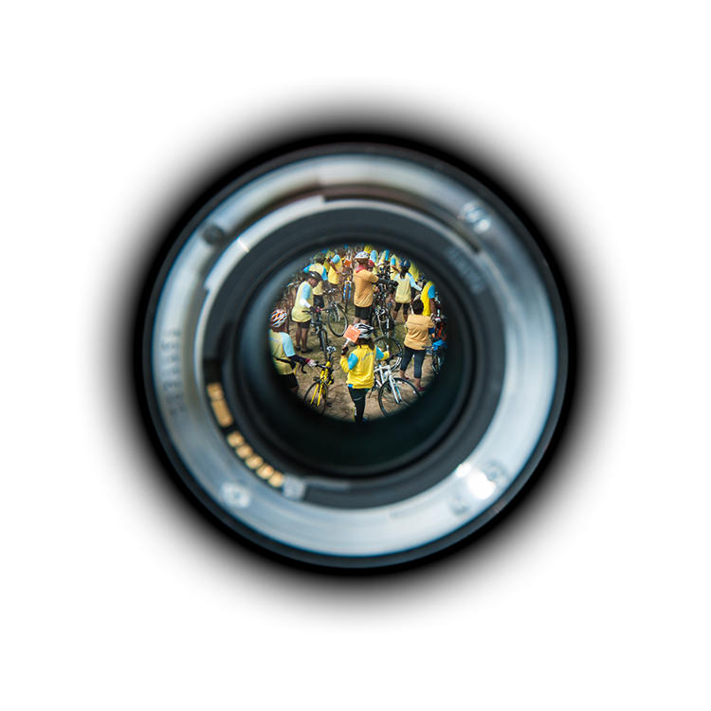

Image Recognition & Web Crawling
Part 1
Notes:
#[TitlePage]

Slide 2
Image Recognition

Slide 3








Capabilities of Image Recognition Providers
 | # Provider | Google Cloud | IBM Watson | Media Distillery | EyeEm | Amazon Recognition | Clarifai | Talkwalker | Meltwater
Face Detection | 3 | 3 | 2 |  |  | 1 | (X)
Face Recognition | 0 |  |  |  |  | (X*)
Celebrity Detection | 1 |  |  |  |  |  | 1
Label Detection | 5 | 3* | 5* |  | 2 | 4 | 1*
Logo Detection | 2 | 2 |  | 1* |  |  | (X) | (X)
Text Detection | 2 | 1 | 2 | (X)
Landmark Detection | 1 | 1
Color Detection | 1 | 1 |  |  |  |  | (X)
Focus Detection | 0 |  |  |  |  |  | (X)
Caption Detection | 1 |  |  |  | 1
Aesthetic Score | 1 |  |  |  | 1
NSFW Score | 2 | 1** |  |  |  |  | 1**
Speech Detection | 1 | 1 |  | (X)
Video Analysis | 1 | 1
Value = Rank across all testet providers
0 = Test ongoing, but not ranked yes
(X) = Capability in development stage
Notes: * Self training capability of model available for detection
**Models for NSFW score are not comparable

Slide 4
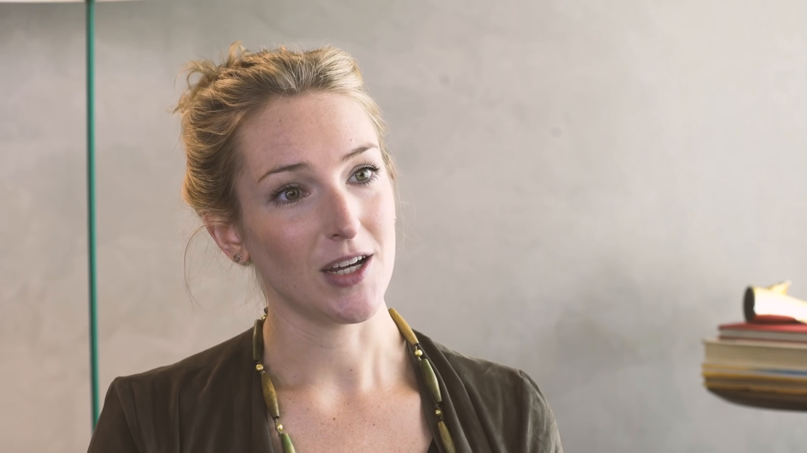
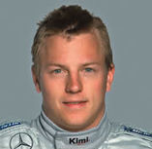
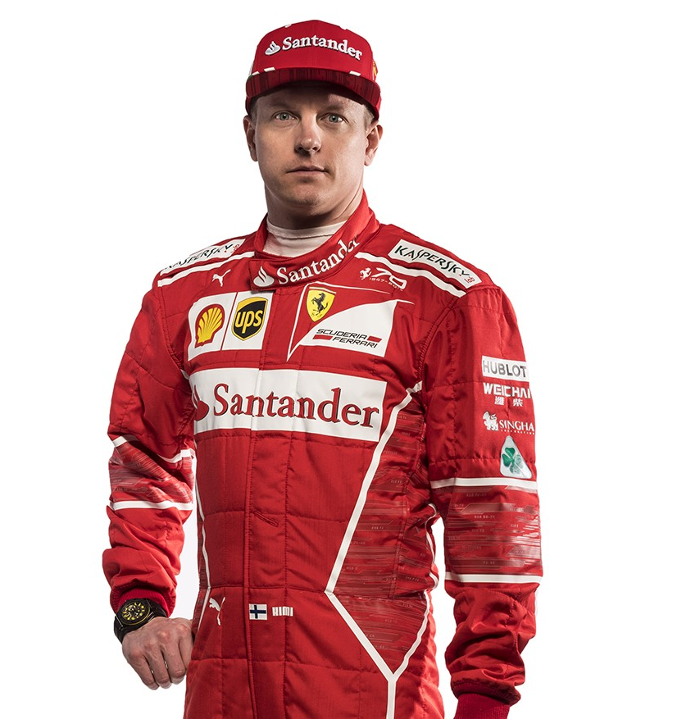
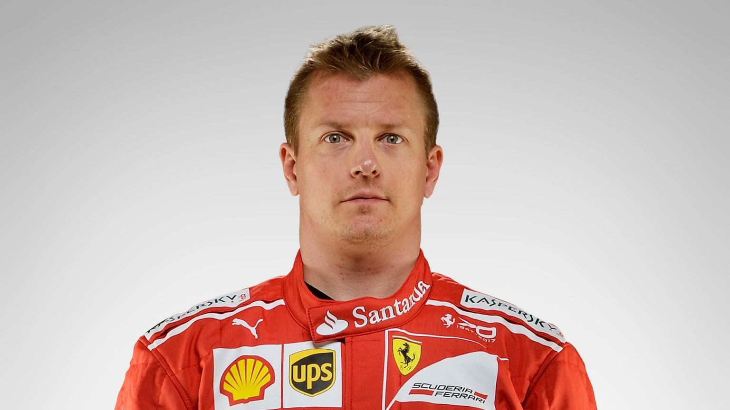
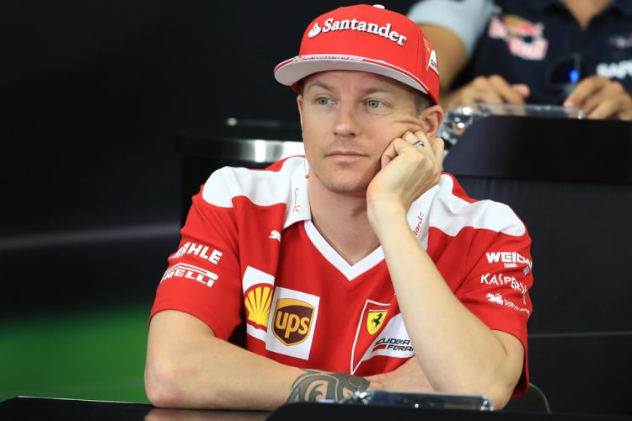
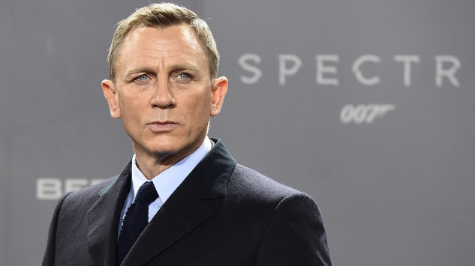
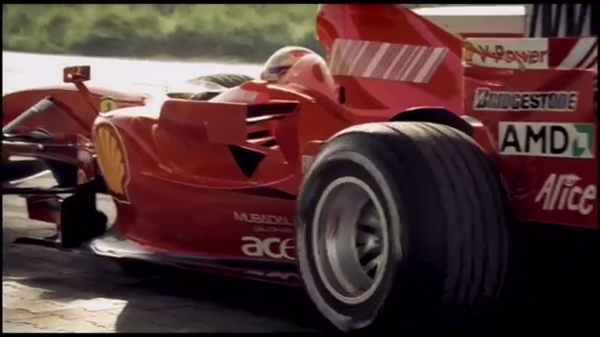
Image Recognition Services
Face Detection
Face Recognition
Train API for a face
Kimi Raikkonen: 99.2%
Coordinates
Age range:
27 - 44
Facial expressions:
Eyes open
Celebrity Recognition
Label Detection
Daniel Craig: 99.1%
Vehicle
Red
Outdoors
Racecar
Tire

Slide 5
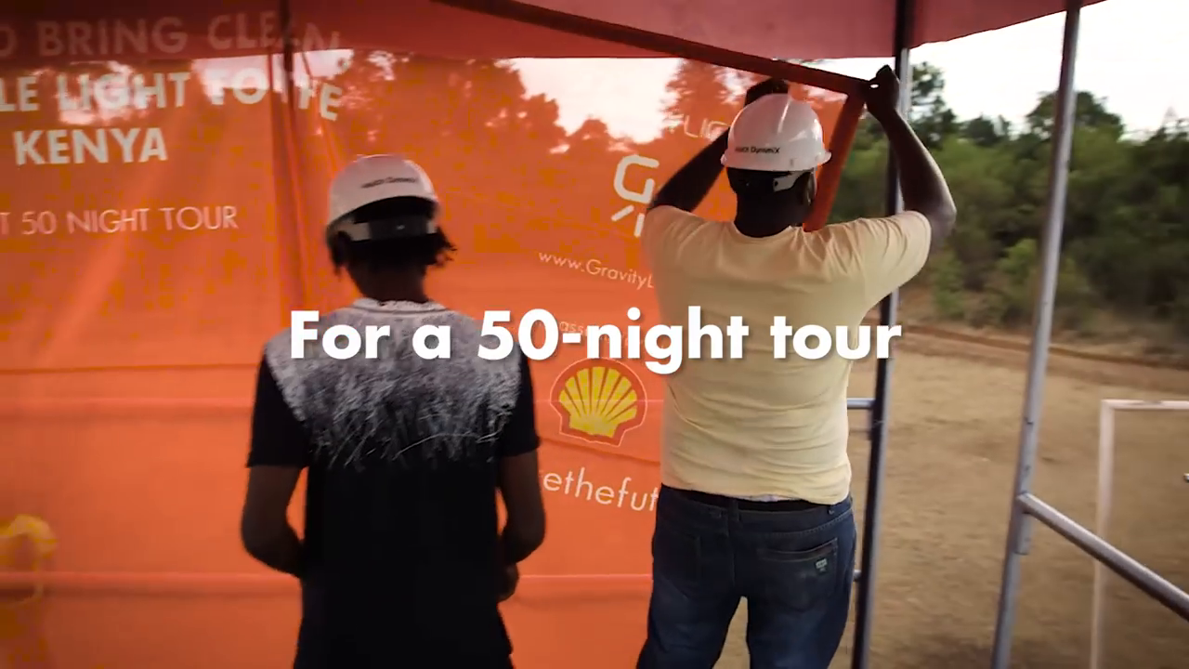
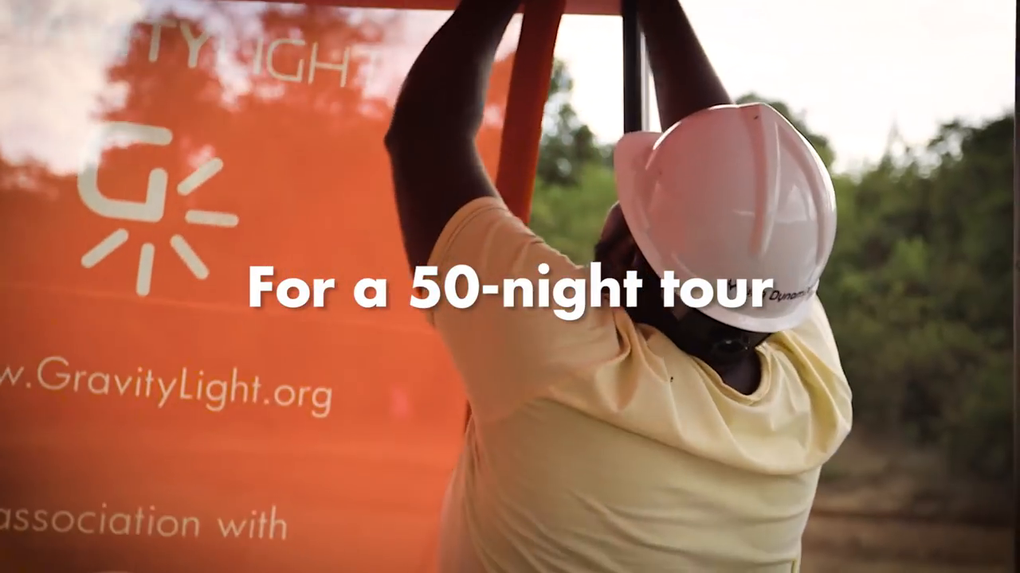
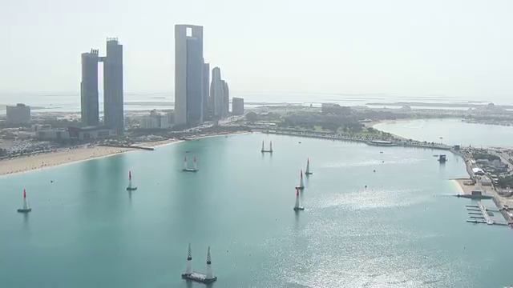
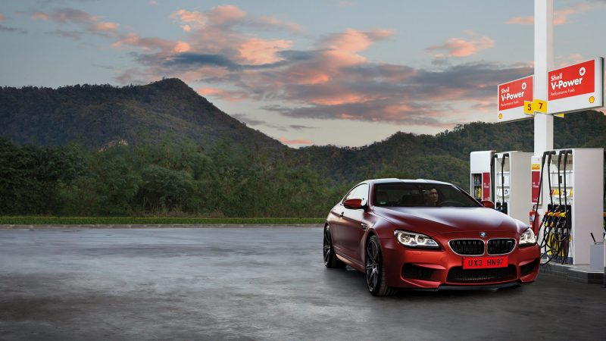
Image Recognition Services
Logo Detection
Text Detection
GravityLight.org
Shell
For a 50-night tour
ssociation with
Landmark Detection
Colour Detection
Fraction
0.19
0.12
Abu Dhabi
0.11
0.07
0.07

Slide 6
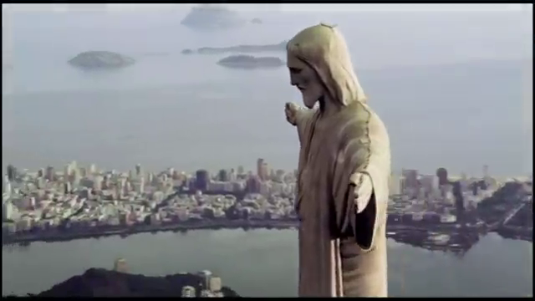
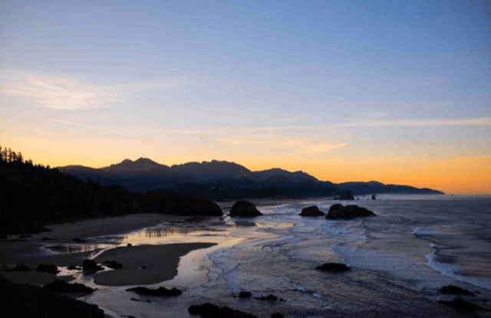
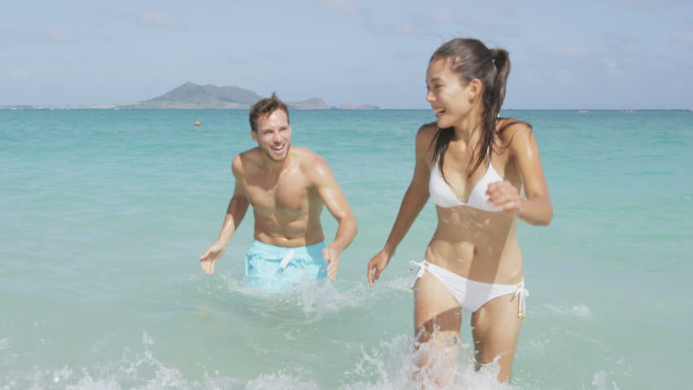
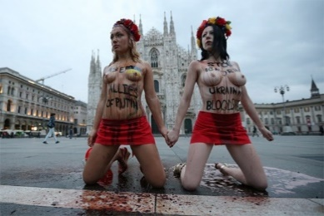
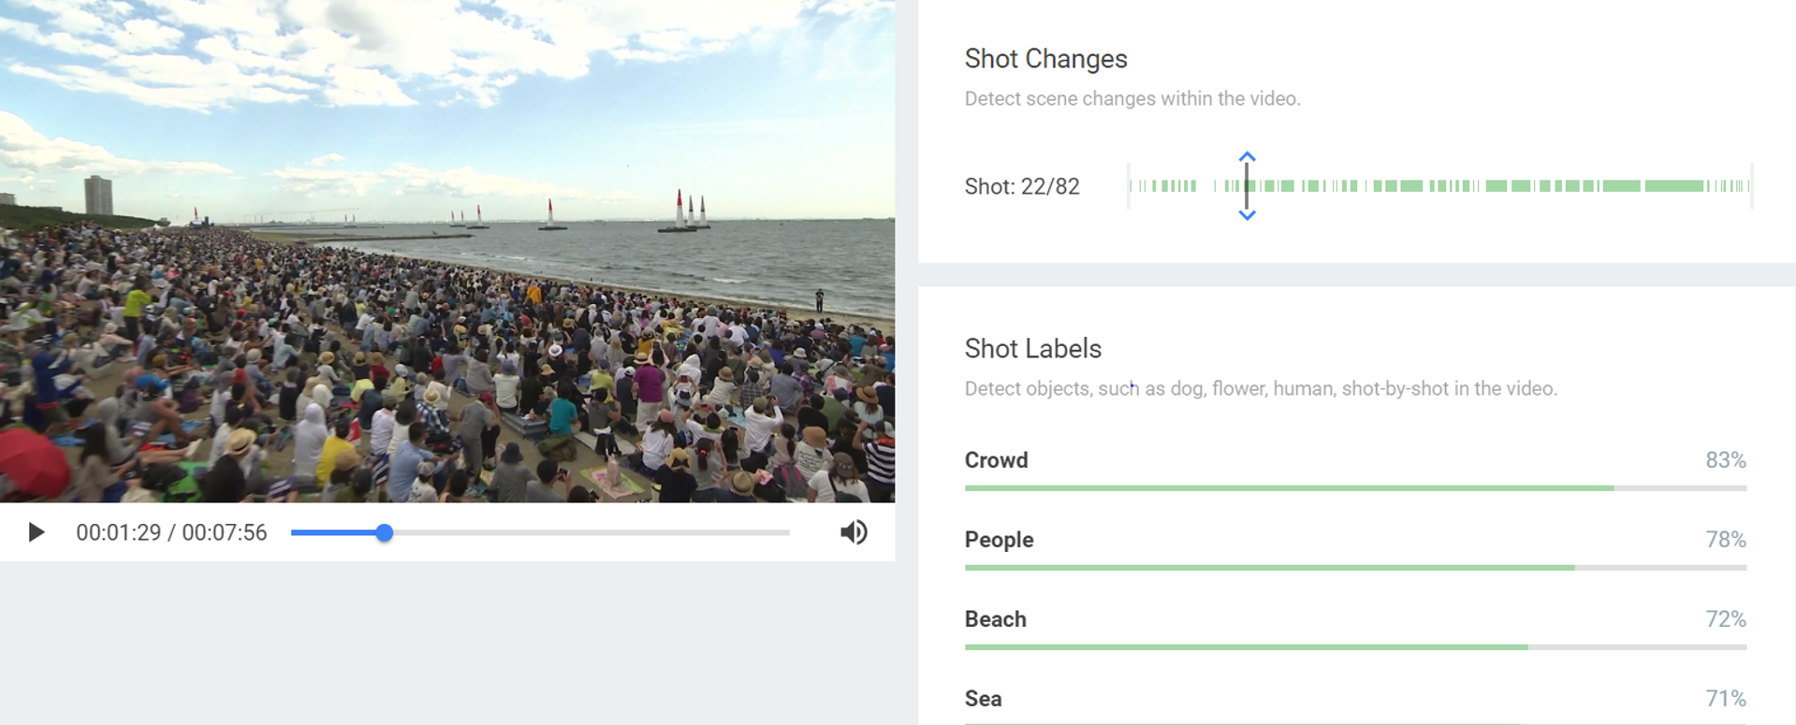
Image Recognition Services
Caption Detection
Aesthetic Score
„Statue in City“
96%
Not Safe For Work (NSFW)
Video Analysis
1.1%
59.8%

Slide 7
Video Analysis

Slide 8
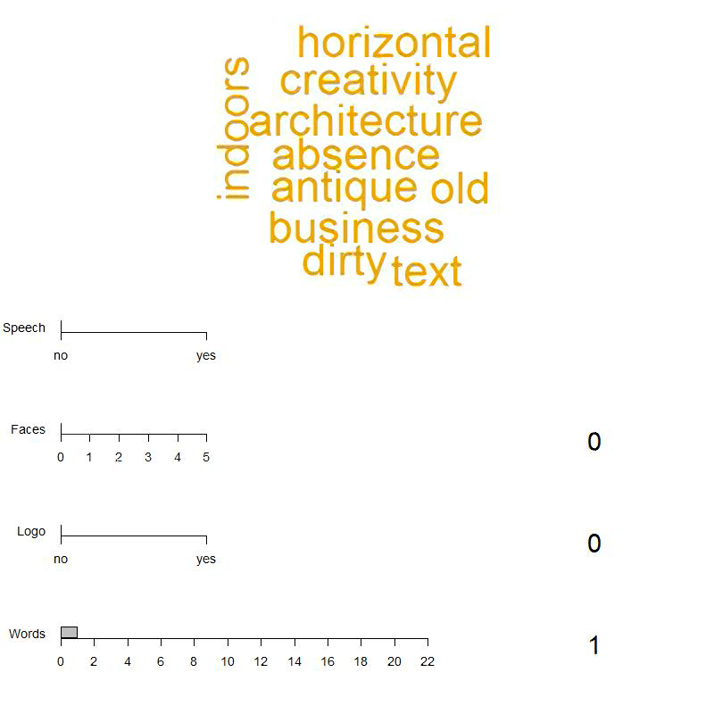

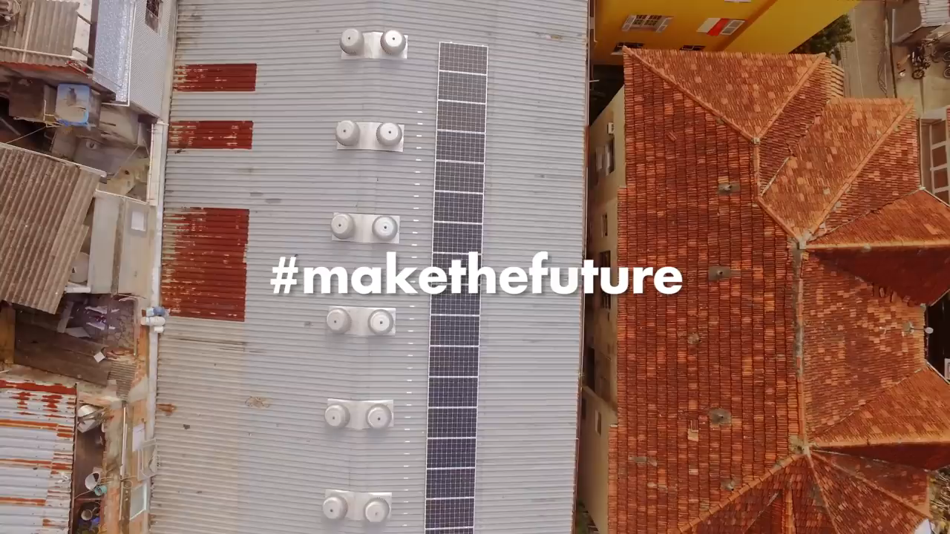
Video Analysis
Combination of best image recognition APIs to evaluate the video
Label Detection:
Video starts once viewed in slide show

Slide 9
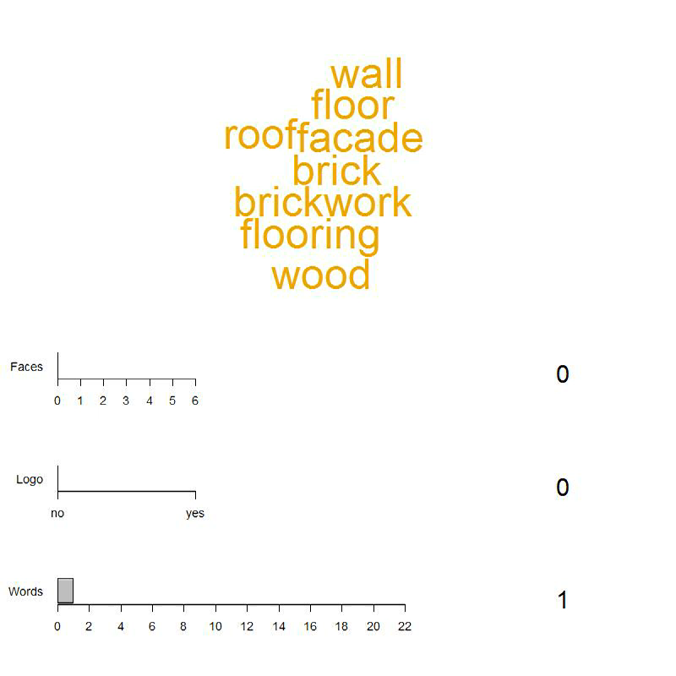
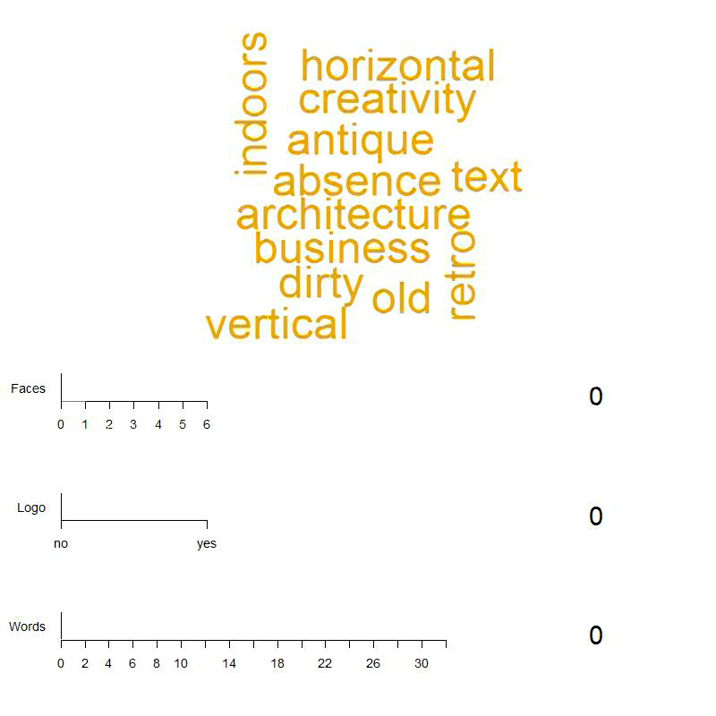

Google vs. Other APIs - Video Analysis
Comparison of Google image recognition APIs to other image recognition APIs
Label Detection:
Label Detection:
VS.
Video starts once viewed in slide show

Slide 10


Google vs. Media Distillery – Logo Detection in Video Analysis
From the video analysis on the previous slide below shows the video frames in which the Royal Dutch Shell logo is detected.
The API which detected the logo can be found in the coloured boxes at the top of the images:
Google Vision API
Google Vision API
Media Distillery
Media Distillery
Logo in Focus
Logo Faded
Logo Angled
This Analysis Shows How Logo Detection Services Perform Differently!

Slide 11
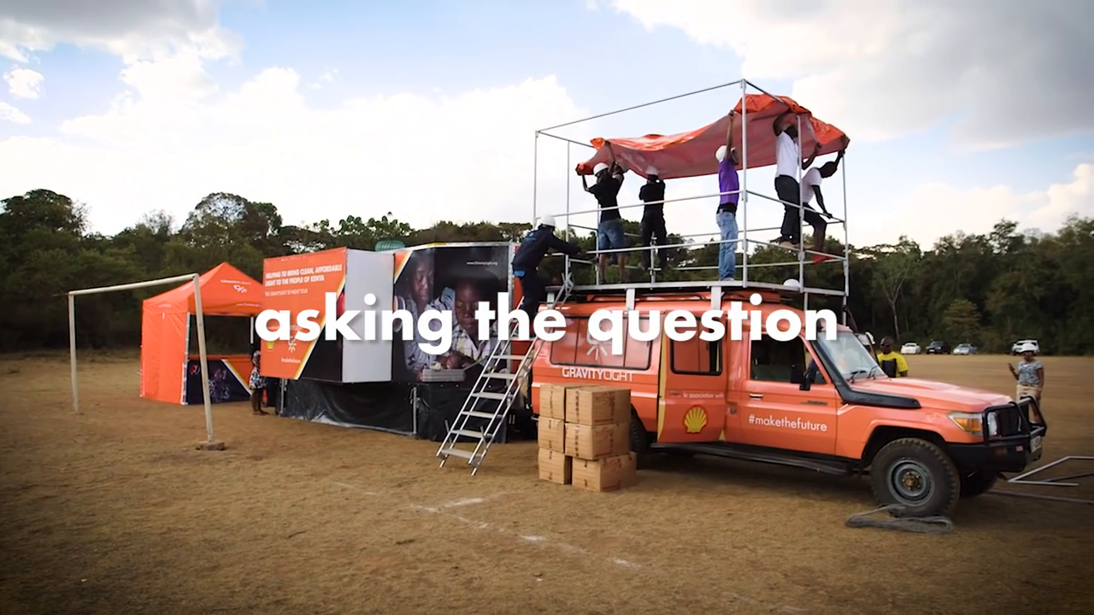
Google vs. Media Distillery– Logo Detection in video analysis
API Detection for Remarkable Logos
API Detection for Unremarkable Logos
Remarkable logo: a logo that is obvious within an image or a video frame and can clearly be seen by the human eye.
Taking the previous video as an example the below shows a frame with a remarkable logo:
Number of images with remarkable logos tested was 204:
Media Distillery detected the branded logo in 139 images (68%)
Google Vision detected the branded logo in 68 images (33%)
Combining both APIs together the branded logo was detected in 150 images (74%)
Unremarkable logo: a logo that is not obvious within an image or a video frame and cannot clearly be seen by the human eye.
Taking the previous video as an example the below shows a frame with an unremarkable logo:
Number of images with unremarkable logos tested was 360:
Media Distillery detected the branded logo in 52 images (14.4%)
Google Vision detected the branded logo in 14 images (3.8%)
Combining both APIs together the branded logo was detected in 58 images (16.1%)
* Please note branded image does not refer to Shell branded images and the images above are just to demonstrate the categories

Slide 12
Image Analysis

Slide 13
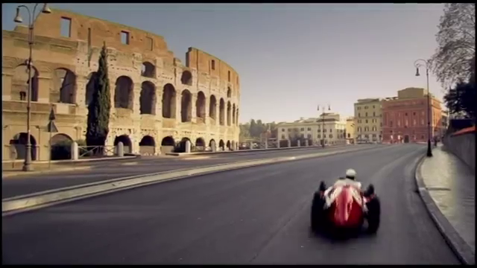
Example 1 – Ferrari 1
 | Google Vision | IBM Watson | Amazon Rekognition | Clarifai | EyeEm | Media Distillery
Faces | - | - | -
Text | - | -
Logo | - |  |  |  |  | -
Labels
 | Google Vision |  | IBM Watson |  | Amazon Rekognition |  | Clarifai |  | EyeEm |  | Media Distillery
1 | Car | 0.98 | Amphitheater | 0.97 | Road | 0.89 | Travel | 0.98 | Built Structure | 0.99
2 | Land Vehicle | 0.98 | Sports Stadium | 0.97 | Street | 0.89 | Architecture | 0.97 | Architecture | 0.99
3 | Landmark | 0.94 | Black Color | 0.87 | Town | 0.89 | City | 0.97 | History | 0.96
4 | Vehicle | 0.90 |  |  | Lamp | 0.68 | Street | 0.96 | Real People | 0.96
5 | Road | 0.90 |  |  | Pole | 0.68 | Road | 0.96 | Travel | 0.91
6 | Lane | 0.89 |  |  |  |  | Outdoors | 0.94 | Travel Destination | 0.82
7 | Infrastructure | 0.88 |  |  |  |  | Building | 0.94 | Transportation | 0.75
8 | Town | 0.88 |  |  |  |  | Tourism | 0.94 | Day | 0.73
9 | Mode of Transport | 0.88 |  |  |  |  | Sky | 0.94 | Building Exterior | 0.70
10 | Street | 0.86 |  |  |  |  | Horizontal Plane | 0.93 | Outdoors | 0.64
 | EyeEm
Aesthetic | -0.71
Caption | Rear view of a woman on the road View of historical building View of a building Rear view of a woman in the dark
 | Google Vision
Landmarks | Colosseum Rome

Slide 14
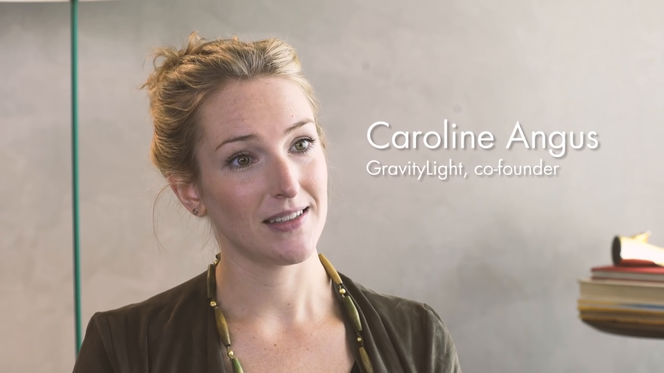
Example 2 – Interview 1
 | Google Vision | IBM Watson | Amazon Rekognition | Clarifai | EyeEm | Media Distillery
Faces | 1 Face | 1 Face, 18 - 24 years, Female | 1 Face, 26 - 44 years, Female
Text | Caroline Angus GravityLight, co-founder | -
Logo | - |  |  |  |  | -
Labels
 | Google Vision |  | IBM Watson |  | Amazon Rekognition |  | Clarifai |  | EyeEm |  | Media Distillery
1 | Eyebrow | 0.87 | Person | 0.77 | People | 0.99 | Facial Expression | 0.98 | Text | 0.95
2 | Hairstyle | 0.82 |  |  | Person | 0.99 | Woman | 0.98 | One Person | 0.94
3 | Chin | 0.79 |  |  | Human | 0.99 | Portrait | 0.98 | Front View | 0.91
4 | Forehead | 0.72 |  |  | Book | 0.91 | People | 0.97 | Indoors | 0.90
5 | Professional | 0.62 |  |  | Text | 0.91 | Adult | 0.97 | Looking at Camera | 0.84
6 | Girl | 0.57 |  |  | Skin | 0.83 | Indoors | 0.97 | Blonde Hair | 0.77
7 | Smile | 0.57 |  |  | Blonde | 0.79 | Wear | 0.97 | Education | 0.76
8 | Brown Hair | 0.53 |  |  | Female | 0.79 | One | 0.97 | Portrait | 0.75
9 | Hair Coloring | 0.51 |  |  | Woman | 0.79 | Sky | 0.94 | Confidence | 0.73
10 |  |  |  |  | File Binder | 0.68 | Happiness | 0.88 | Beautiful Woman | 0.68
 | EyeEm
Aesthetic | 0.60
Caption | Portrait of mature man Portrait of young woman with text Portrait of young woman with text in background Portrait of young man with text
 | Google Vision
Landmarks | -

Slide 15
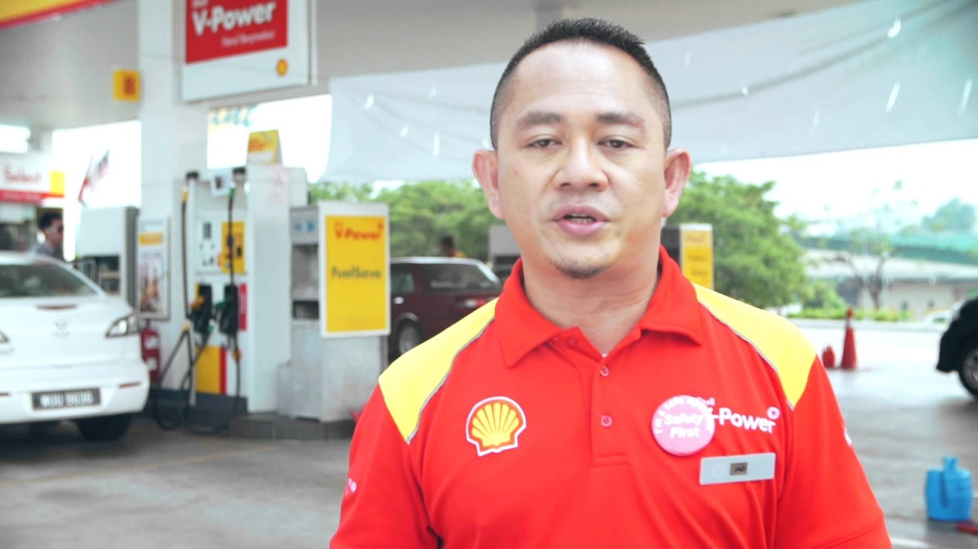
Example 2 – Interview 2
 | Google Vision | IBM Watson | Amazon Rekognition | Clarifai | EyeEm | Media Distillery
Faces | 1 Face | 1 Face, 18 - 24 years, Male | 1 Face, 35 – 52 years, Male
Text | VPower | -
Logo | - |  |  |  |  | Shell
Labels
 | Google Vision |  | IBM Watson |  | Amazon Rekognition |  | Clarifai |  | EyeEm |  | Media Distillery
1 | Car | 0.95 | Person | 0.85 | People | 0.99 | People | 0.98 | One Person | 0.96
2 | Vehicle | 0.86 |  |  | Person | 0.99 | Soccer | 0.98 | Uniform | 0.93
3 | Profession | 0.83 |  |  | Human | 0.99 | Man | 0.98 | Real People | 0.93
4 | Automotive Design | 0.73 |  |  | Automobile | 0.98 | Competition | 0.97 | Standing | 0.91
5 | Official | 0.70 |  |  | Car | 0.98 | Portrait | 0.97 | Portrait | 0.86
6 | Motor Vehicle | 0.63 |  |  | Vehicle | 0.98 | Industry | 0.97 | Day | 0.79
7 | T-shirt | 0.61 |  |  | First Aid | 0.69 | Adult | 0.96 | Red | 0.69
8 | Job | 0.61 |  |  | Logo | 0.69 | Rescue | 0.95
9 | Professional | 0.51 |  |  | Red Cross | 0.69 | Vehicle | 0.94
10 |  |  |  |  |  |  | Auto Racing | 0.93
 | EyeEm
Aesthetic | -0.69
Caption | Portrait of man standing outdoors Portrait of mid adult man standing outdoors Portrait of mature man standing outdoors
 | Google Vision
Landmarks | -

Slide 16
Summary
Providers
Multiple provides offer image recognition
Services
Image recognition encompasses a variety of services
Quality
The quality of the results differs across providers and services
Development
Image recognition is an innovative and rapidly developing field

Slide 17
Other Capabilities

Slide 18
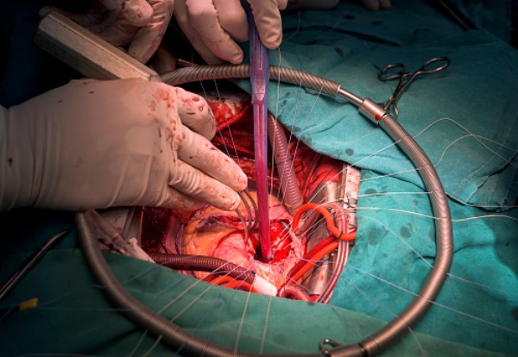
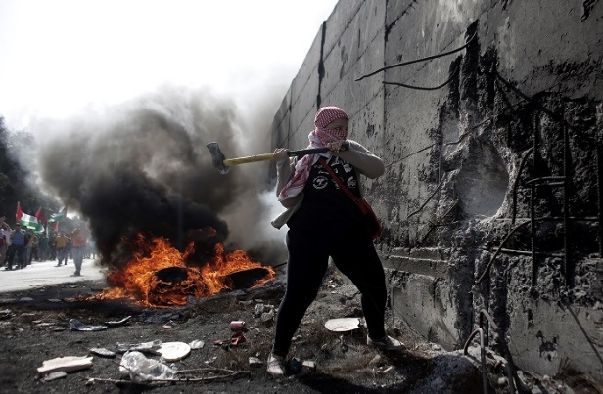
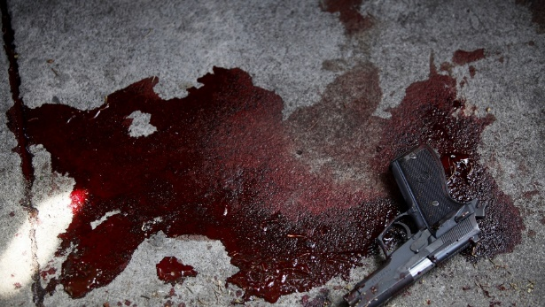
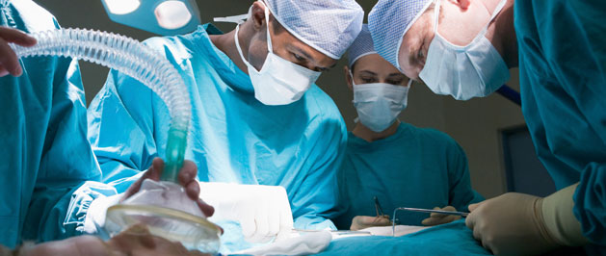
Safe Search/Not safe for work (NSFW)
 | Google Vision | Clarifai
Adult | Very unlikely
Medical | Very unlikely
Spoofed | Very unlikely
Violence | Unlikely
NSFW |  | 0.1%
 | Google Vision | Clarifai
Adult | Unlikely
Medical | Possible
Spoofed | Very unlikely
Violence | Likely
NSFW |  | 0.2%
 | Google Vision | Clarifai
Adult | Very unlikely
Medical | Unlikely
Spoofed | Very unlikely
Violence | Very likely
NSFW |  | 0.3%
 | Google Vision | Clarifai
Adult | Very unlikely
Medical | Very unlikely
Spoofed | Very unlikely
Violence | Possible
NSFW |  | 0.7%

Slide 19
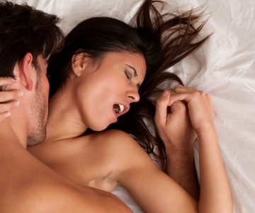

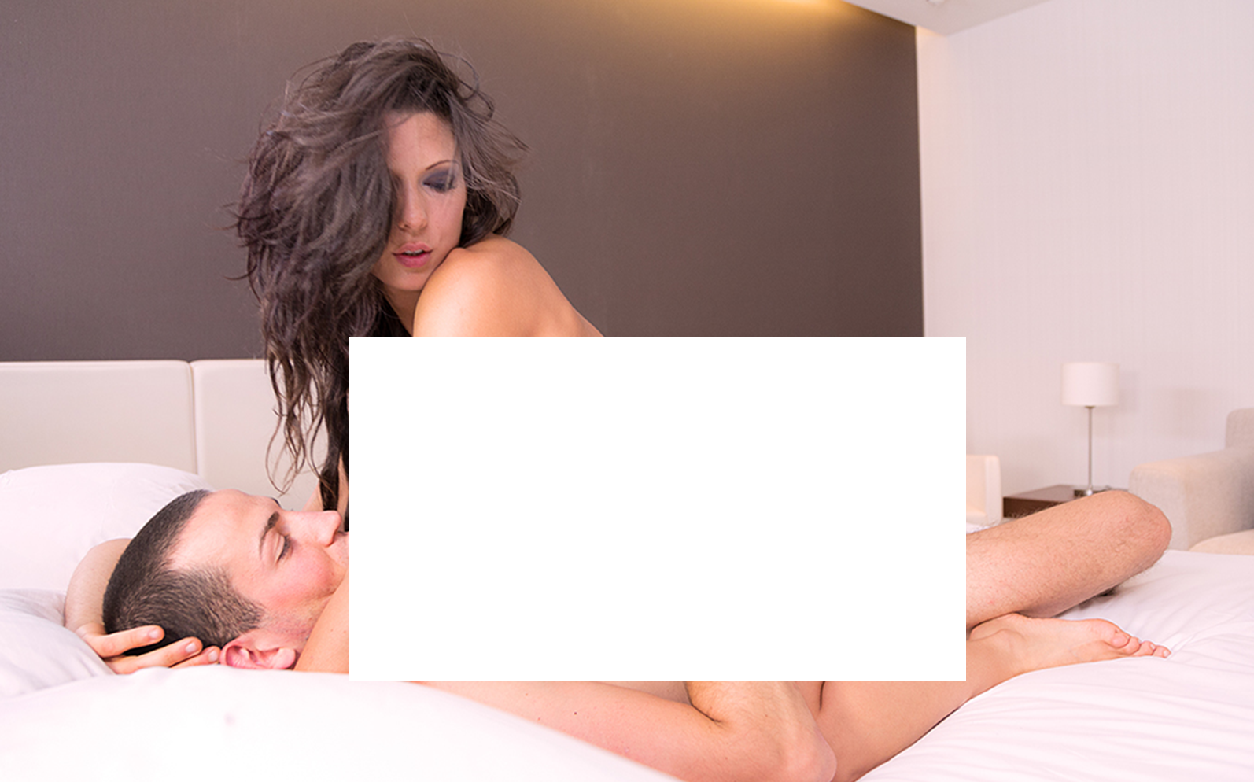
Safe Search/Not safe for work (NSFW)
 | Google Vision | Clarifai
Adult | Unlikely
Medical | Unlikely
Spoofed | Very unlikely
Violence | Very unlikely
NSFW |  | 1.1%
 | Google Vision | Clarifai
Adult | Unlikely
Medical | Very unlikely
Spoofed | Very unlikely
Violence | Unlikely
NSFW |  | 59.8%
 | Google Vision | Clarifai
Adult | Likely
Medical | Very unlikely
Spoofed | Very unlikely
Violence | Very unlikely
NSFW |  | 85.1%
 | Google Vision | Clarifai
Adult | Very likely
Medical | Unlikely
Spoofed | Very unlikely
Violence | Very unlikely
NSFW |  | 99.6%

Slide 20
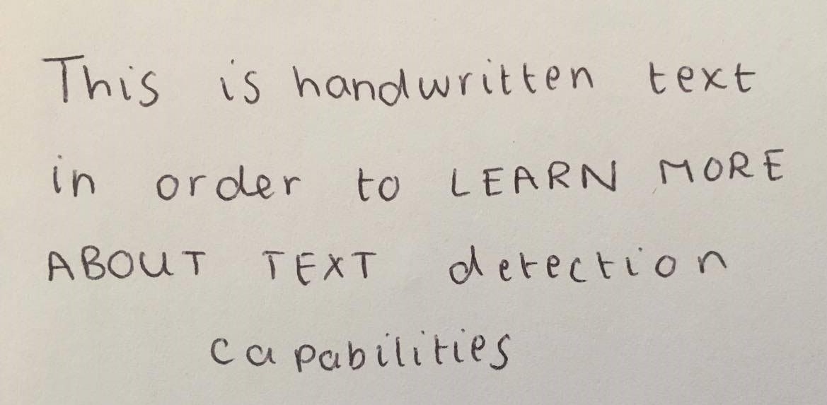
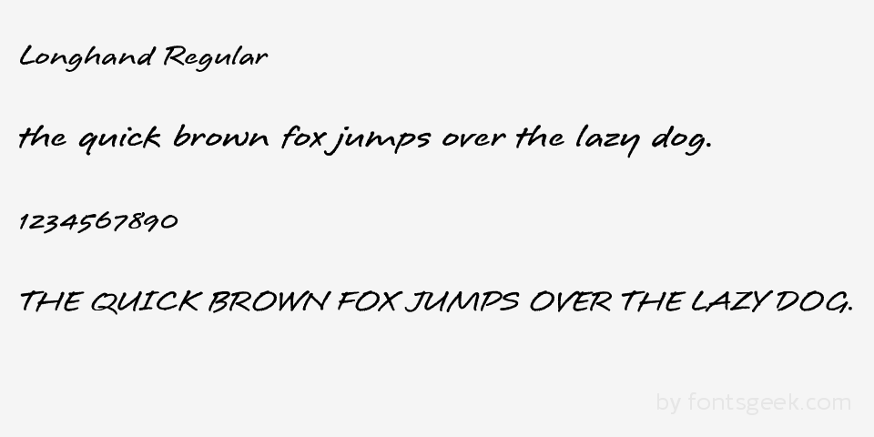
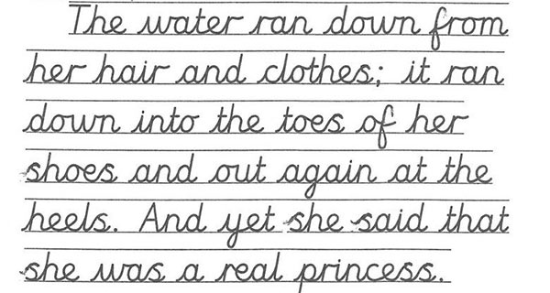
Text Recognition - Handwriting Google
This is hanod written text
in oroler to LEARN MORE
ABouT TEXT o erecti o n
C c pabilities
Longhand Regular
nanan
the quick bronn fox juhmps over the lazy dog.
1234567890
THE QWICK BROWN FOX JUMMPs OVER THE LAZYDOG
The water ran down rom
naur an
downinto the toes ot her
heels.Anduet she saidthat
shewas.a real princess

Slide 21
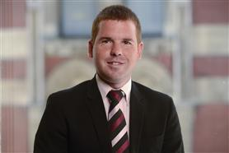
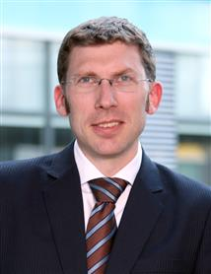
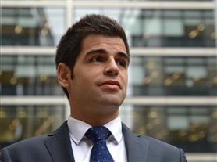
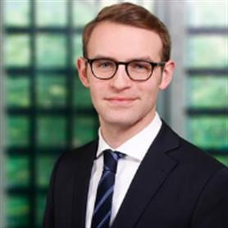
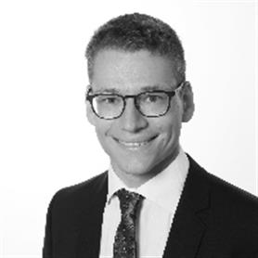
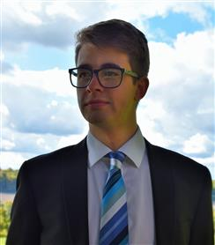
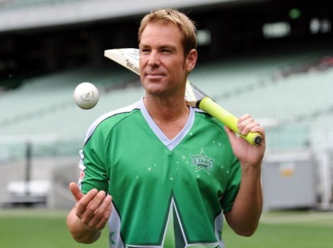
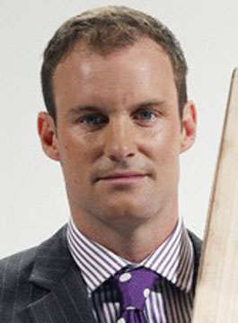
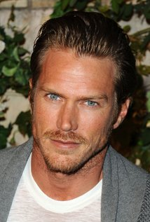
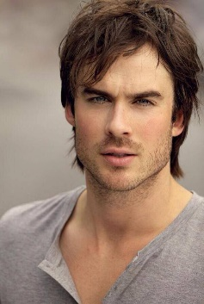
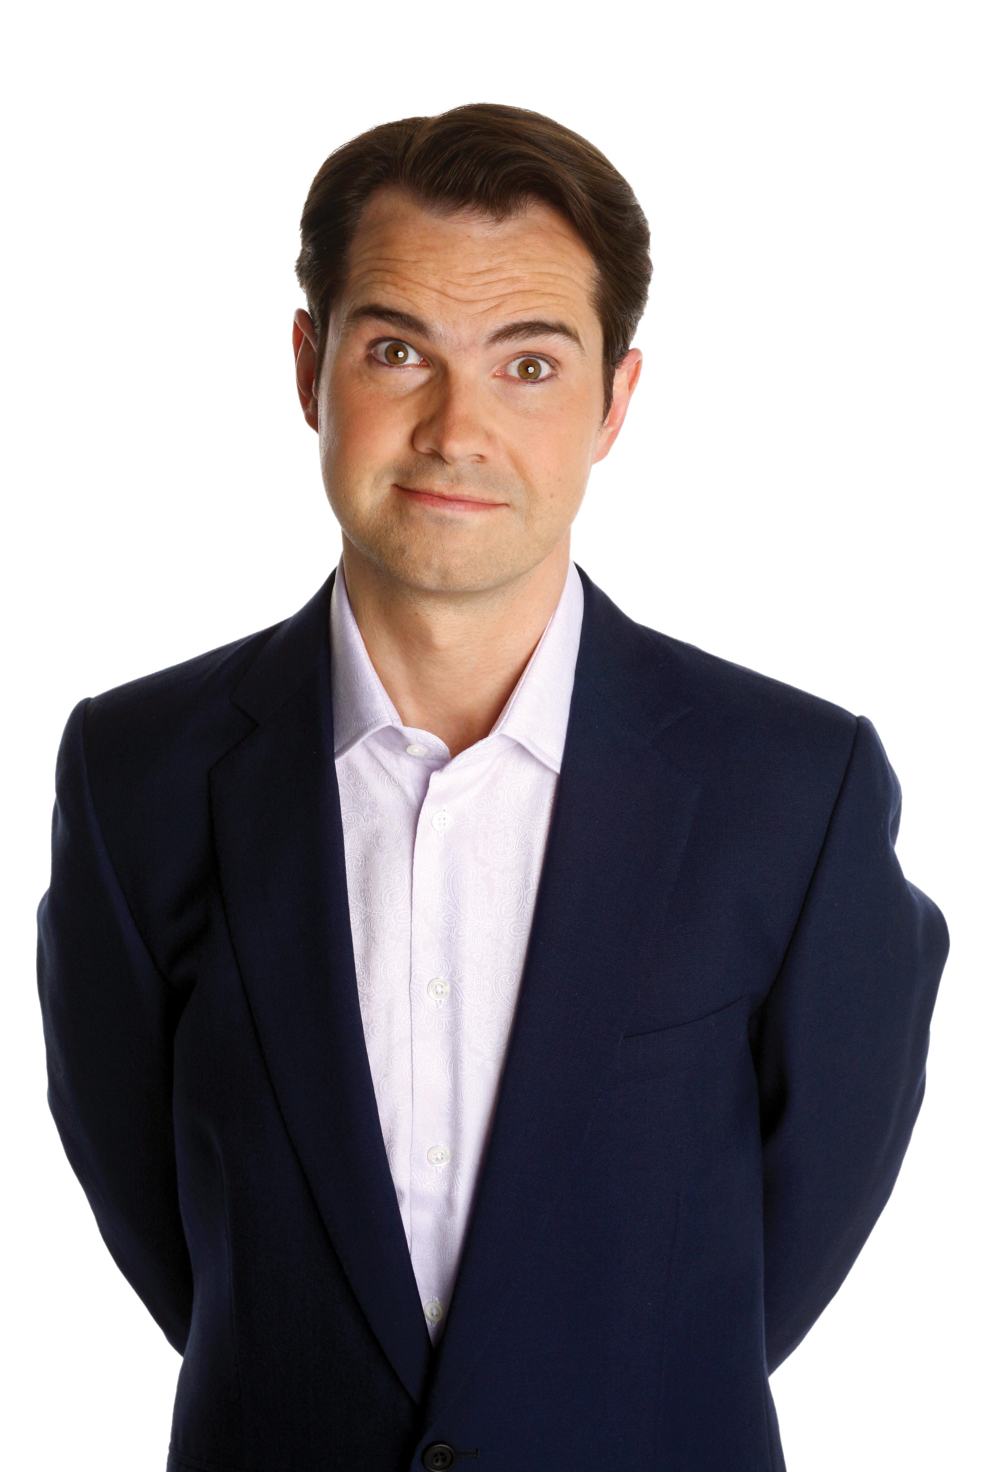
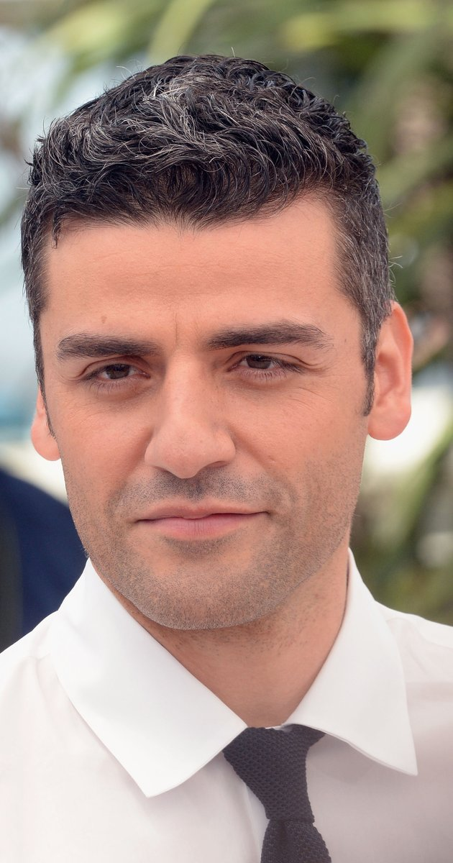
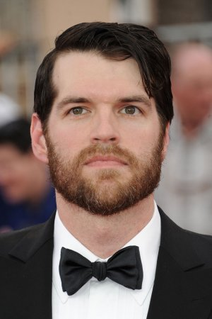
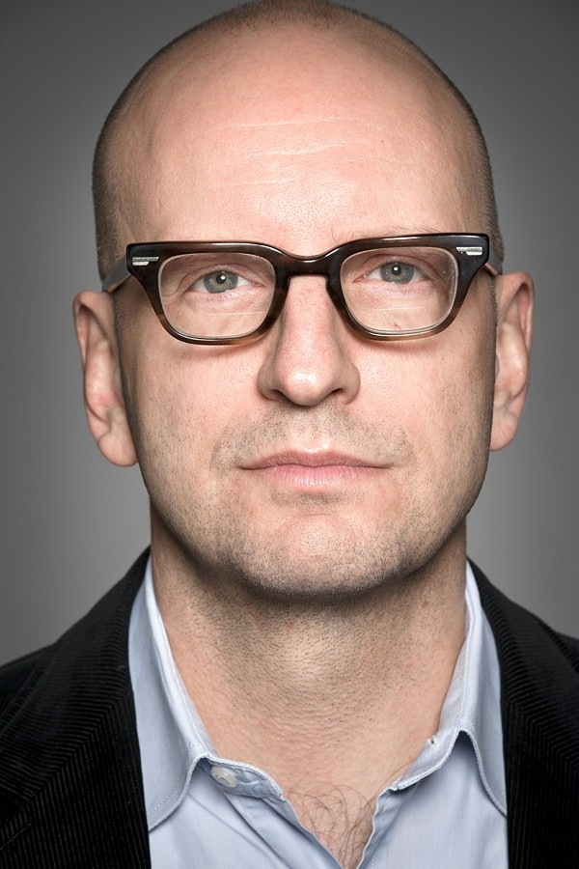
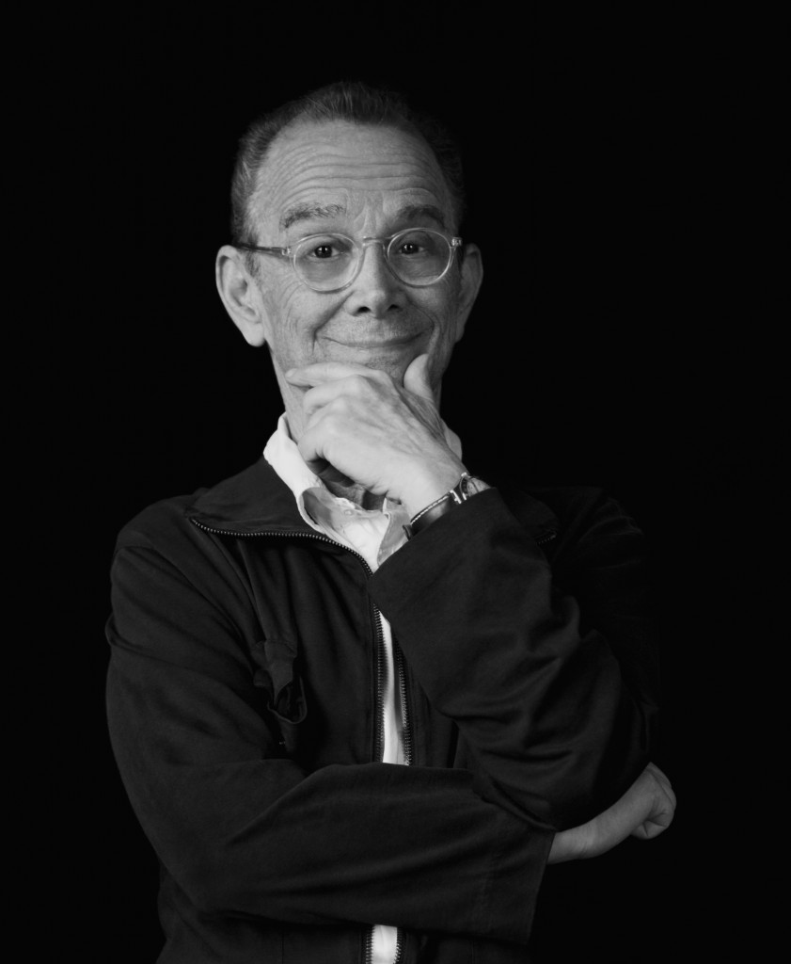
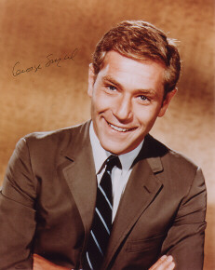








Celebrity Capability – Meet the Team
Craig Turnbull
Thoms Klingspor
Tomas Meca
Tobias Hess
Christian Reisser
Daniel Coates
Clarifai Celebrity Check:
Clarifai Celebrity Check:
Clarifai Celebrity Check:
Clarifai Celebrity Check:
Clarifai Celebrity Check:
Clarifai Celebrity Check:
Clarifai Results:
Clarifai Results:
Clarifai Results:
Clarifai Results:
Clarifai Results:
Clarifai Results:
Shane Warne
Andrew Strauss
Jason Lewis
Ian Somerhalder
Jimmy Carr
Oscar Issac
Timothy Simons
Steven Soderbergh
Joel Grey
George Segal
Colin Hanks
Tyler Hoechlin
1.0 %
0.90 %
6.7 %
0.67 %
6.4 %
1.4 %
2.5 %
2.5 %
4.1 %
2.2 %
0.23 %
0.11 %
Ellie Katsouris
Amy summers
Clarifai Celebrity Check:
Clarifai Results:
Clarifai Celebrity Check:
Clarifai Results:
Kate Harrison
Margo Harshman
Elsa zylberstein
Vera Farmiga
2.2 %
1.6 %
8.0 %
2.9 %

Slide 22
Improving Outputs

Slide 23
















Improving Outputs
Split Frames
Combine APIs
Train Classifier
Benefit from Developments
Quality of Image
Split frame into multiple frames in order to increase the number of labels per picture
Combine outputs of multiple APIs in order to detect e.g. branded images via logo and text
Train the classifier by feeding in large amounts of different pictures with e.g. Shell logo
Benefit from the development of the API algorithm over time through improved outputs
Improving the quality of the image can increase the accuracy of the detection
Thousands of pictures with Shell logo
Compressed Image*
API called in April ´17
Label:
„Screenshot“
Top Label:
„Plant“
Media Distillery does not detect the logo
Google does detect text „V-Power“
Identical picture
Classifier
Normal Non-Compressed Image*
API called in July ´17
New images
Top Label:
„Road“
Labels:
„Atmosphere earth“, „sky“
*Using Amazon as the Image tagging API

Slide 24
Split Frames – Google API
Original Frame
Split into 4 pieces
Picture
Labels | Arch, Architecture, History, built Structure, Ancient, Day, Outdoors | City, Tree, Clear Sky, Outdoors, Cityscape, Travel Destinations
Picture
Labels | Architecture, Built Structure, No People, Building Exterior, Close-up | Road, Transportation, Street, Outdoors, No people, Road Sign, Tree
Picture
Labels | Architecture, Built Structure, Building Exterior, History, Outdoors, Travel Destinations, Arch
VS.

